Slide 1
Business Intelligence and Business Analytics (H9BIBA)

Slide 2
Module Content
Intelligent Enterprises
Agile Enterprises, Operating Strategies, Continuous Improvement Programs
Enterprise Systems
Evolution – MRP, CL MRP, MRP II, ERP, ES Packages, Balanced Scorecard
BI and Dashboards
Views v Reports, Types of Dashboards, Advantages of Dashboards, The Funnel
Consumer Behaviour models
Behaviourist v Cognitivist, Lawson’s, EKB, and Howard and Sheth’s models
Operational CRM Systems
Overview and Demo of a commercial system such as Microsoft Dynamics CRM
Implementing Enterprise BI systems
Data Warehousing and Data Marts, Data mining, Online Analytical Process (OLAP)
Implementing CRM systems
Fit-Gap Analysis, Integration with Heterogeneous systems, Data integration, Information Lifecycle Management, Data protection, security and ethical considerations
Customer-Centric Enterprise with CRM
Customer Experience, Customer Loyalty, Customer Relationships, Customer Life Cycle, Customer Value Management
Customer-Responsive Enterprise with SCM
Supply Chain Management, Customer-Responsive Management, B-Webs, Activity Costing techniques
Renewing Enterprise with PLM
Components and Advantages of PLM, Porter’s Framework, Product Life Cycle
Collaborative Enterprise with BPM
BPM, BPR, Business Processes with SOA, Workflows, Analytics
Informed Enterprise with BI
Context-Aware Applications, Decision Patterns and Data mining

Slide 3
Today
Customer-Centric Enterprise with CRM
Customer Experience, Customer Loyalty, Customer Relationships, Customer Life Cycle, Customer Value Management

Slide 4
Customer Experience
Customer experience (also known as CX) is defined by the interactions and experiences your customer has with your business throughout the entire customer journey, from first contact to becoming a happy and loyal customer.
CX is an integral part of Customer Relationship Management (CRM) and the reason why it’s important is because a customer who has a positive experience with a business is more likely to become a repeat and loyal customer.
A study by Oracle found that 74% of senior executives believe that customer experience impacts the willingness of a customer to be a loyal advocate. If you want your customers to stay loyal, you have to invest in their experience!

Slide 5
Customer Experience continue…
If you treat your customers poorly or ignore their customer service emails, then they are more likely to stop doing business with you.
This is why companies that deliver a superior customer experience outperform their competitors.
Note: Customer experience is not the same as customer service.

Slide 6
According to statistics
Customer experience is set to be the number one brand differentiator in 2020 (and beyond)
1 in 3 customers will leave a brand they love after just one bad experience.
Customers are willing to pay a price premium of up to 13% (and as high as 18%) for luxury and indulgence services, simply by receiving a great customer experience.
49% of buyers have made impulse purchases after receiving a more personalized customer experience
Customers that rate companies with a high customer experience score (i.e. 10/10) spend 140% more and remain loyal for up to 6 years.

Slide 7
How to improve the customer experience?
Create a clear customer experience vision.
The first step in your customer experience strategy is to have a clear customer-focused vision that you can communicate with your organization.
This can be achieved by creating a set of statements/guidelines.
Ex: Being humble to customers,.

Slide 8
How to improve the customer experience? Continue…
Understand who your customers are
Connect and empathize with the situations that your customers face.
Create an emotional connection with your customers
Research by the Journal of Consumer Research has found that more than 50% of an experience is based on an emotion as emotions shape the attitudes that drive decisions.
Capture customer feedback in real time
An effective way of doing this is by capturing feedback in real time.

Slide 9
How to improve the customer experience? Continue…
Use a quality framework for development of your team
Identify the training needs for each individual member of your customer support team.
Act upon regular employee feedback

Slide 10
Customer Loyalty
Loyalty is a deeply held commitment to re-buy or re-patronize and preferred product or services, in the future despite situational influences and marketing efforts having the potential to cause switching behavior.
Loyalty can be defined as a customer continuing to believe that your organization’s product/service offer is their best option. It best fulfills their value proposition whatever that may be. They take that offer whenever faced with that purchasing decision.

Slide 11
Customer Loyalty continue…
Customer loyalty is both attitudinal and behavioral tendency to favor one brand over all others, whether due to satisfaction with the product and services, its convenience or performance, or simply familiarity and comfort with the brand.

Slide 12
Customer Loyalty continue…
There is a contractual arrangement with your company.
It takes too much effort or money to change suppliers.
You are currently the low cost provider.
Their relationship is with one of your employees and not with your company.
Habits are hard to break.
They may actually be in the process of finding an alternative supplier.

Slide 13
Types of customer loyalty
No Loyalty:
there is actually a group of customers that is not loyal to brands. This group is usually a small cohort, but it definitely exists. Marketing best practice for this group is to identify what percentage of your customer base falls into this category, and treat the group as a control.
Inertia Loyalty:
This type of loyalty is based on pattern spending and convenience. Customers who fall into this bucket tend to purchase from a certain brand because it is easy to do, or it’s what “they have always done.”

Slide 14
Types of customer loyalty continue…
Latent Loyalty:
This type of loyalty refers to consumers who might not purchase often from a brand (usually because its products/services are set at a seasonal or high-ticket price), but when they do purchase, they always purchase from the one brand.
Premium Loyalty:
This type of loyalty refers to customers who purchase often from a brand, and advocate on the brand’s behalf when they do. Premium loyalty usually plays into a great deal of pride on the customer’s part. If the customer is proud to represent this brand, then they fall into this bucket.

Slide 15
Types of customer loyalty continue…
Reciprocal Loyalty:
Reciprocal loyalty is a premium relationship benefiting both the brand and the consumer. It creates a relationship where consumers support brands through advocacy, purchase behavior, and community participation. As a result, brands then appreciate consumers through investing in their experiences, providing valuable content and thanking consumer with rewards and benefits.

Slide 16
Customer Relationships
Customer relations describes the ways that a company will engage with its customers to improve the customer experience. This includes providing answers to short-term roadblocks as well as proactively creating long-term solutions that are geared towards customer success. Customer relations aims to create a mutually beneficial relationship with the customer that extends beyond the initial purchase.

Slide 17

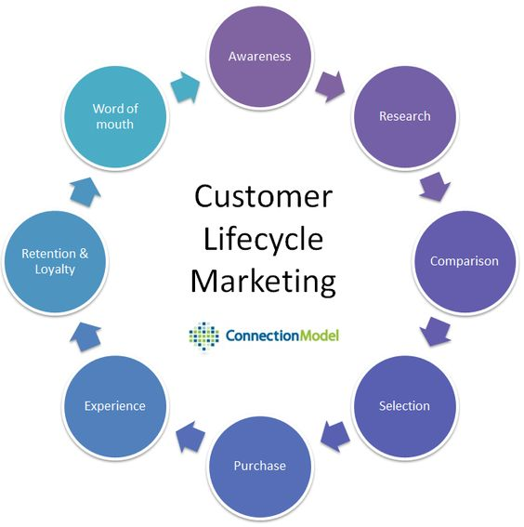
Customer Life Cycle

Slide 18
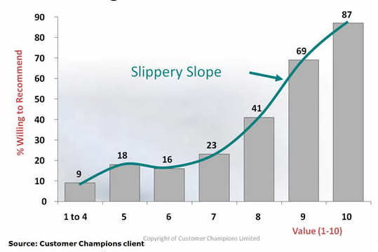
Customer Value Management (CVM)
CVM is a measure of a company’s customers’ view of the perceived value for money delivered relative to that of their competitors’ customers. It is sometimes known as a Customer Value Added (CVA) approach.

Slide 19
Thank you!

